Slide 1
Executable UML
By
Luca Pellicoro

Slide 2
Definitions
Acronym: xtUML or xUML
Technology where models (such as state diagrams and class diagrams) are automatically translated into executable code.
Supports on Model Driven Architecture (MDA)
Allows for Platform Independent Models (PIM)

Slide 3
Machine Instructions:
Models
C++ - Java
Human Tasks
C
Assembly
Machine code
Hardware - switches

Slide 4
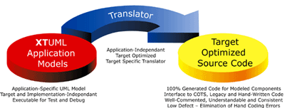
How it works

Slide 5
Exectuable UML vs UML
xUML is a subset of UML:
  Less association types (no aggregation and composition)
  Assications are always named
  No multi-value attibutes
  Multiplicities are always stated

Slide 6
Advantages and difficulties
Rapidly generate efficient code
Good teaching tool
Higher abstraction level: design not implementation
Ultimate OO
Translation: static vs dynamic models
No more coding errors, only design errors!

Slide 7
References
Wikipedia article on executable UML: http://en.wikipedia.org/wiki/Executable_UML
Image: http://www.embedded.com/showArticle.jhtml?articleID=192200349
Exploring the Role of Executable UML in Model-Driven Architecture: http://www.awprofessional.com/articles/article.asp?p=28274&rl=1

